Slide 1
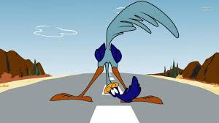
Road Runner
Anna Chatzipapadopoulou
P3200219
Department Of Informatics

Slide 2
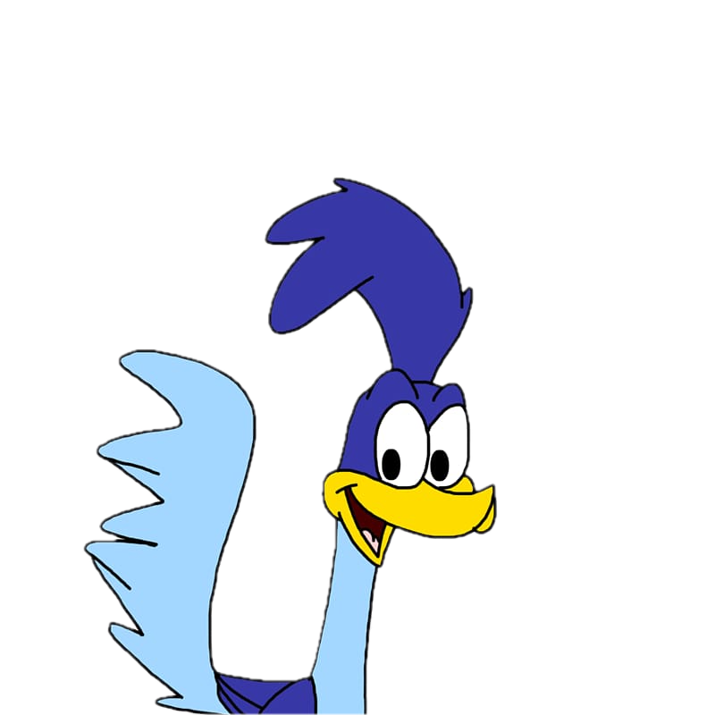
Introduction
Road Runner is an exciting endless runner game implemented in Python using the pygame library. In this game, players control a character, (Beep) as it dashes through a dynamic desert environment. The objective is to navigate through obstacles, avoid collisions, and survive as long as possible while collecting points.
Enjoy the thrill of endless running, challenge yourself to achieve high scores!

Slide 3
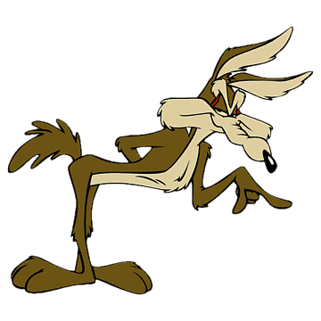
Game Overview
Scrolling Backgroung with different landscapes
Player Controls:
press to move to the right
press to move to the left
press. to jump
Scoring System -> New Levels
Lives
Obstacles

Slide 4
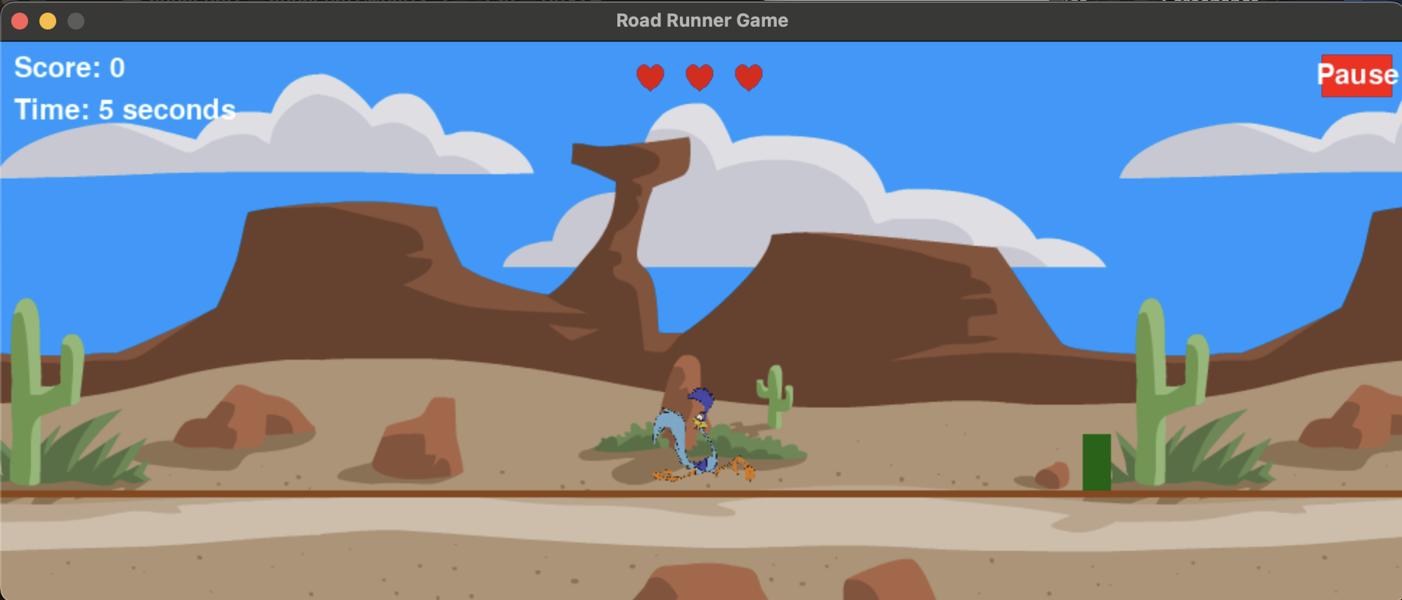
Obstacles – Scoring System
Start: 3 Lives
Purpose: Avoid Collision
Collision -> one less Life
Each passing Obstacle -> +1 point

Slide 5
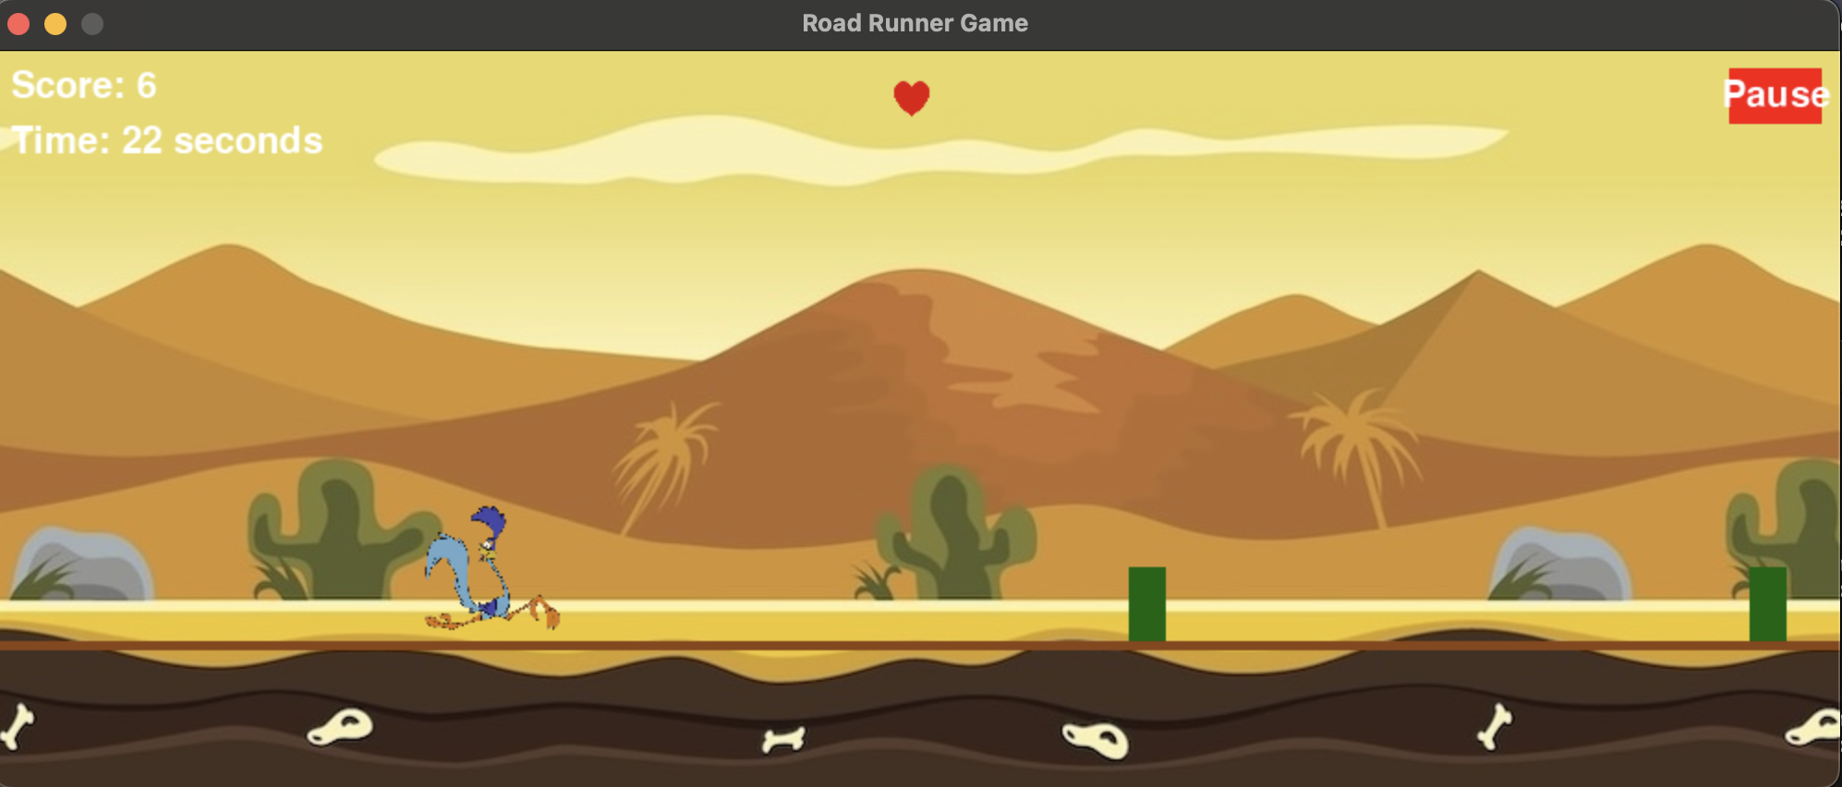
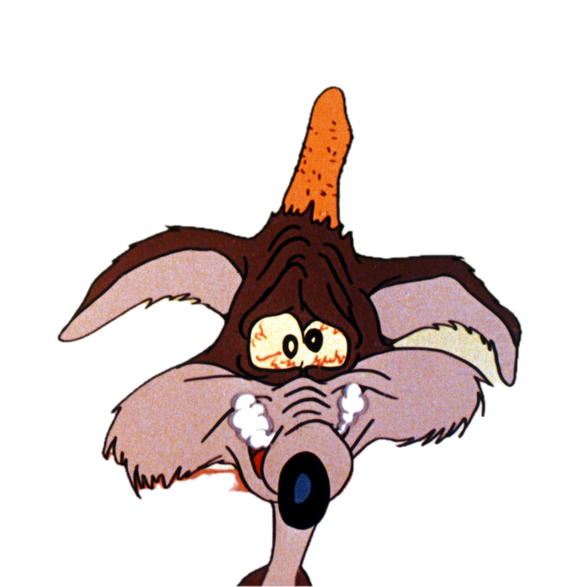
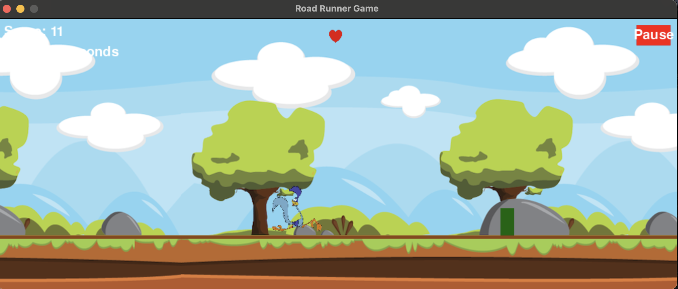
Levels
Level 1
Level 2
Level 3
Higher Speed

Slide 6
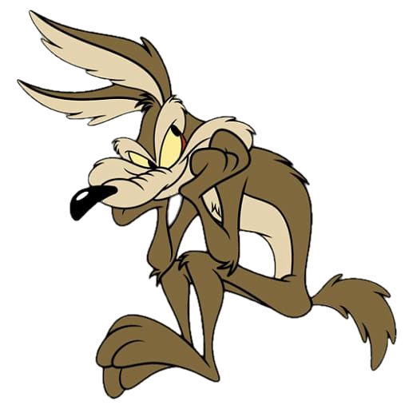
Future Improvements
Add our favorite Co – Star the Coyote
Power-ups and Bonuses
More LandScapes

Slide 7
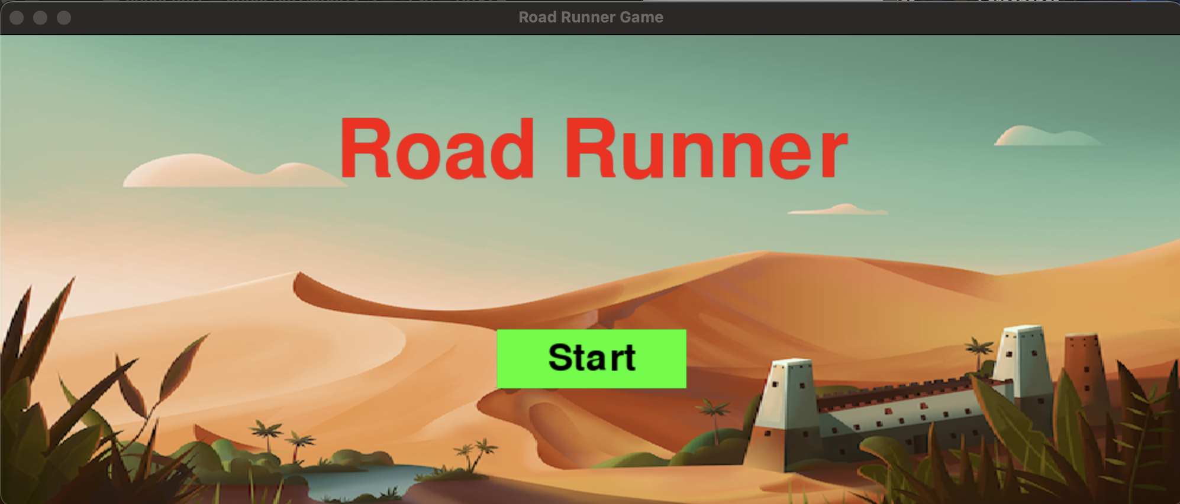
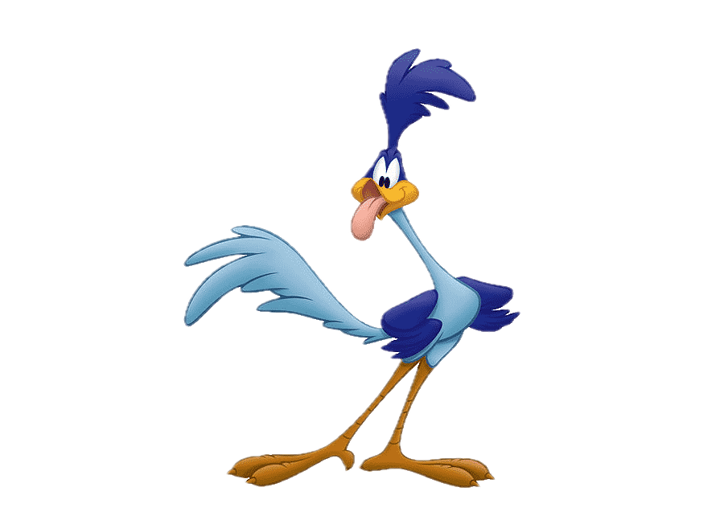
Time to test your skills
Can you keep up?

